Slide 1

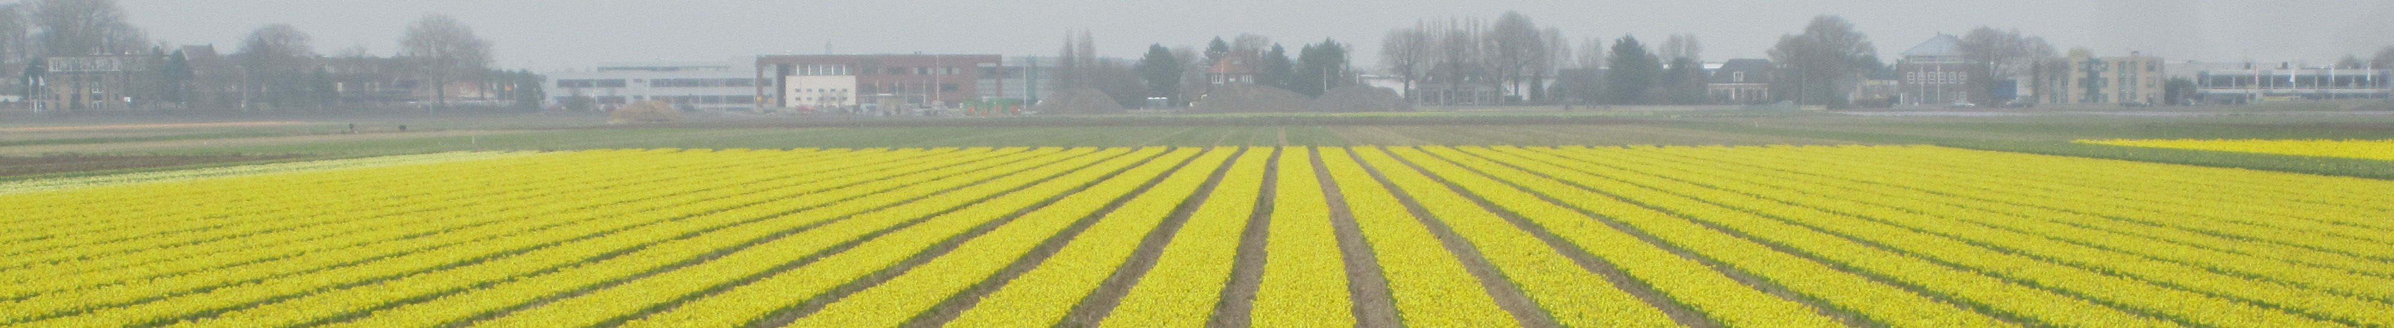

Dan Bolser, EMBL-EBI
trans-National Infrastructure for Plant Genomic Science
Ensembl Genomes: Overview Poznań, 27th-28th June 2013

Slide 2

Ensembl
A modular suite of software for genome analysis and visualisation
developed by the Wellcome Trust Sanger Institute and the European Bioinformatics Institute
Now used for genomes from across the taxonomic space (including plants and plant pathogens)
Notes:
2

Slide 3
Ensembl
Offers a standard set of interfaces to a wide range of genome-scale data, including:
Web-based GUI
APIs (Perl, REST)
Public MySQL server
FTP data download
Data mining tool (constructed using BioMart)
web GUI, web services, command line and local client
Notes:
3

Slide 4
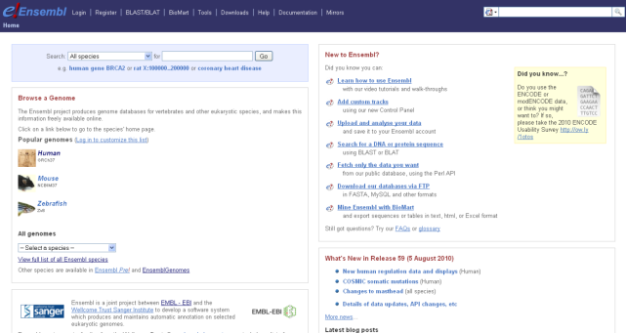

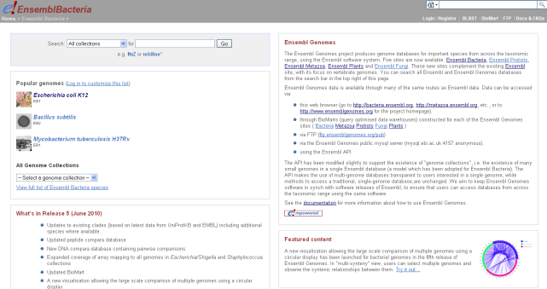
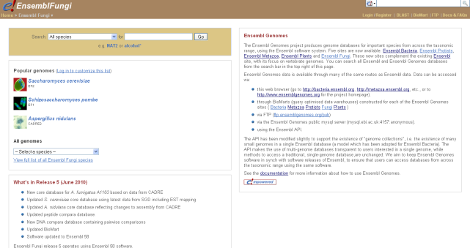
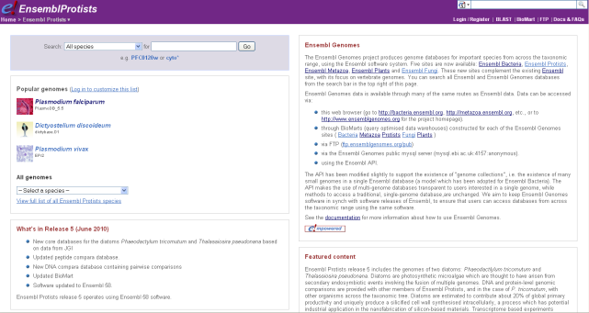



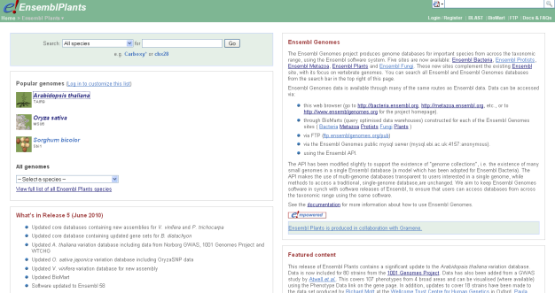
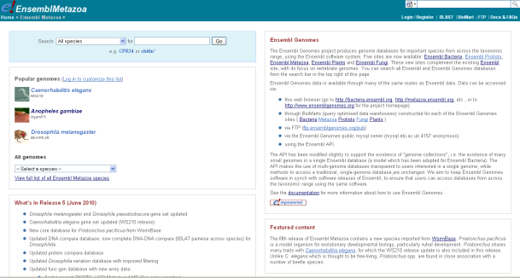



Slide 5
Ensembl and agriculture
Scope of Ensembl Plants includes important crop and model species
Ensembl Metazoa, Protists, Fungi and Bacteria include important agricultural pathogens, pests, pollinators, symbiotes
Important farm animals (cow, sheep, pig, chicken, etc.) among the key species in vertebrate Ensembl

Slide 6
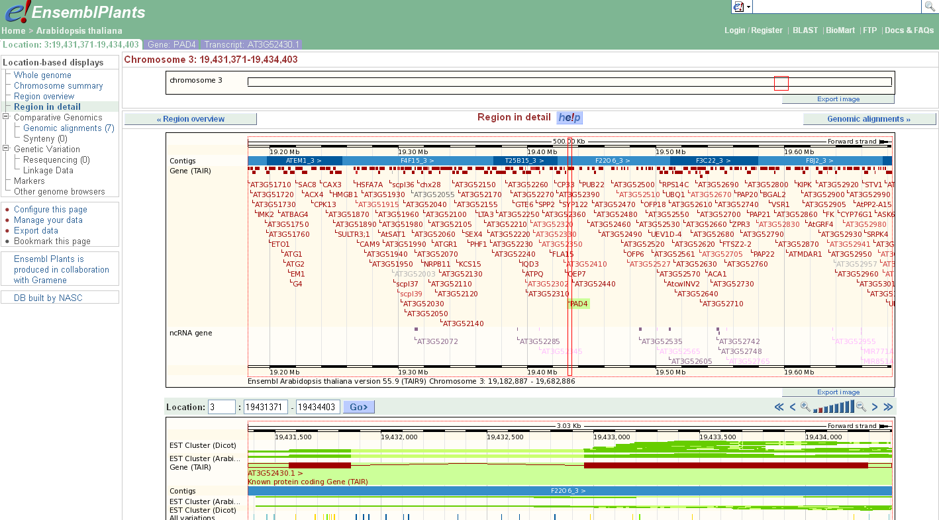

Slide 7
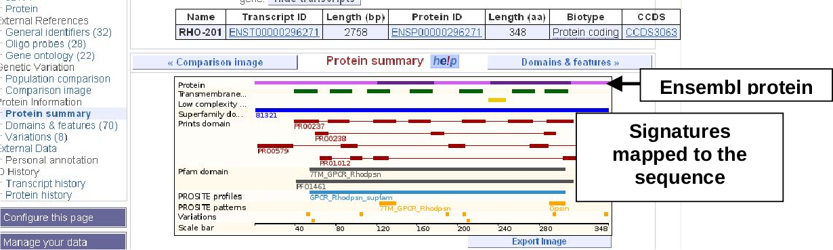

Slide 8
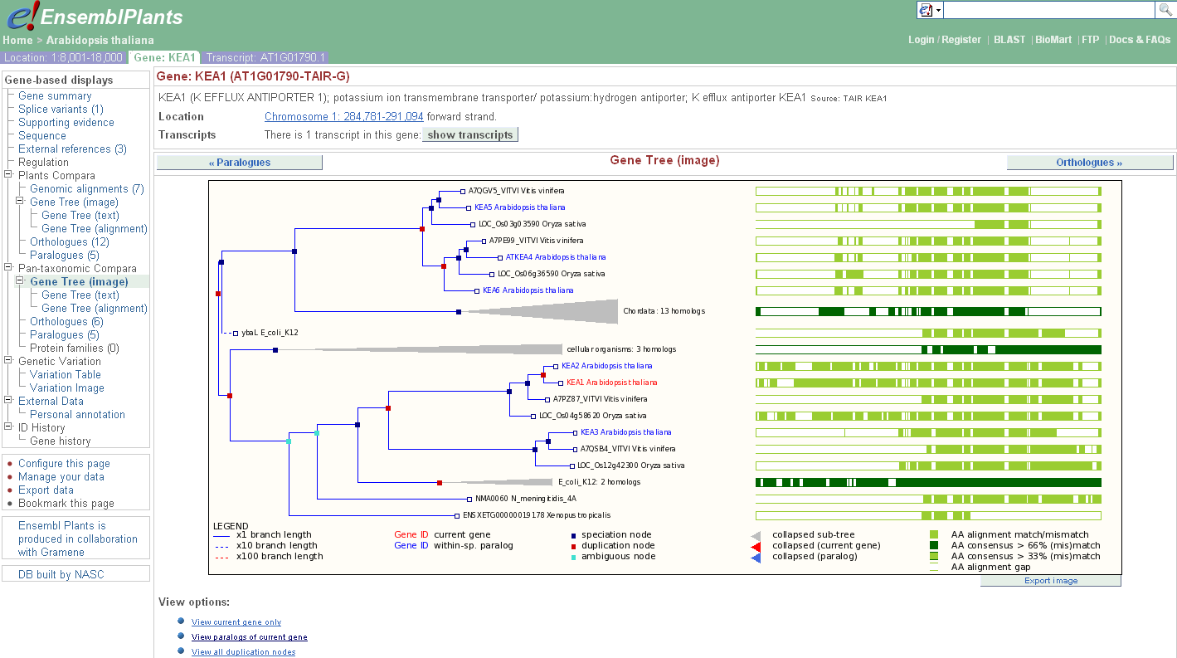

Slide 9
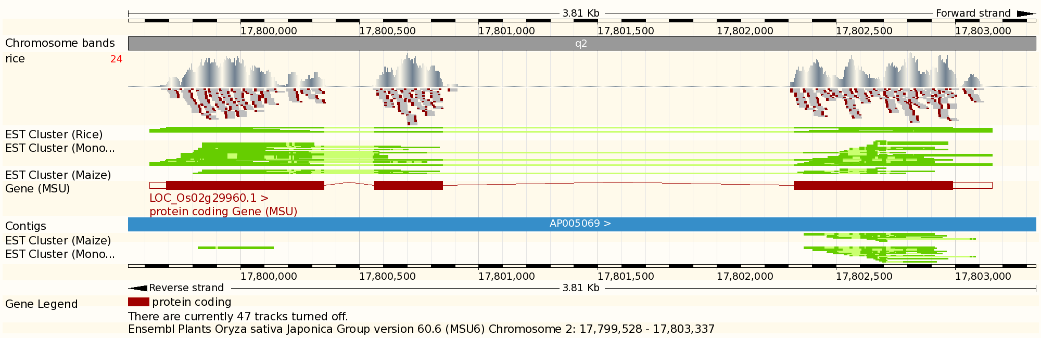

Slide 10
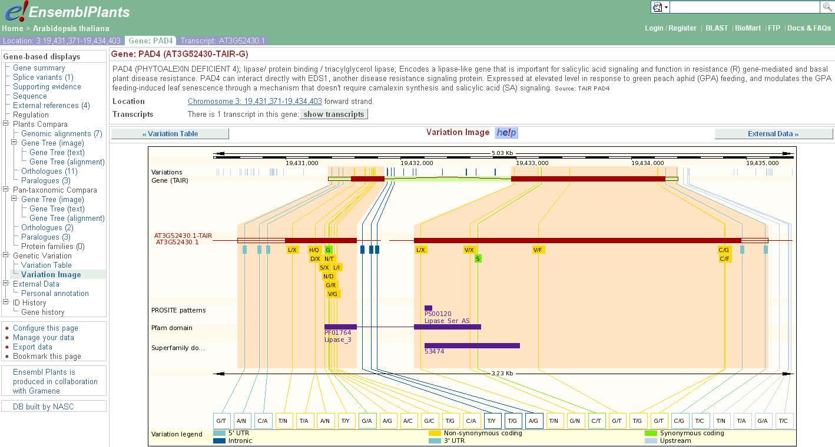

Slide 11
Workshop to follow…
More detail later

